Slide 1
Introduction to Seed Collection
Sept 30, 2023

Slide 2
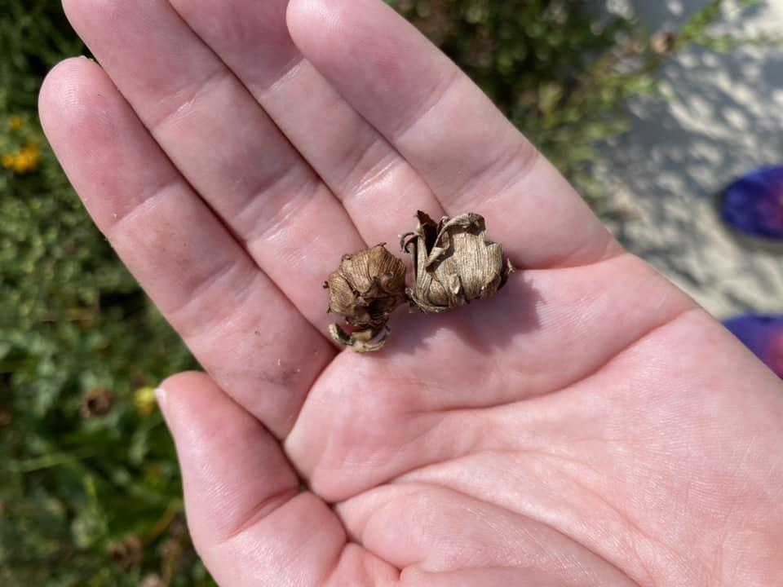
What We’ll Cover
Who am I? Why collect? Permissions & Ethics Preparation Who, What, Where, When, How Equipment Timing Collecting Paper or Plastic The Effect of Temperature Cleaning & Drying Labeling | Storage Stratification Q&A Resources

Slide 3

Introducing Me
Monarch & Pollinators Engagement Coordinator
Lifelong butterfly and gardening lover
Created Rogers Park Monarch Butterfly Project to encourage milkweed planting and map its locations
Started the Birchwood Corner Butterfly Garden last year on my neighborhood street corner

Slide 4
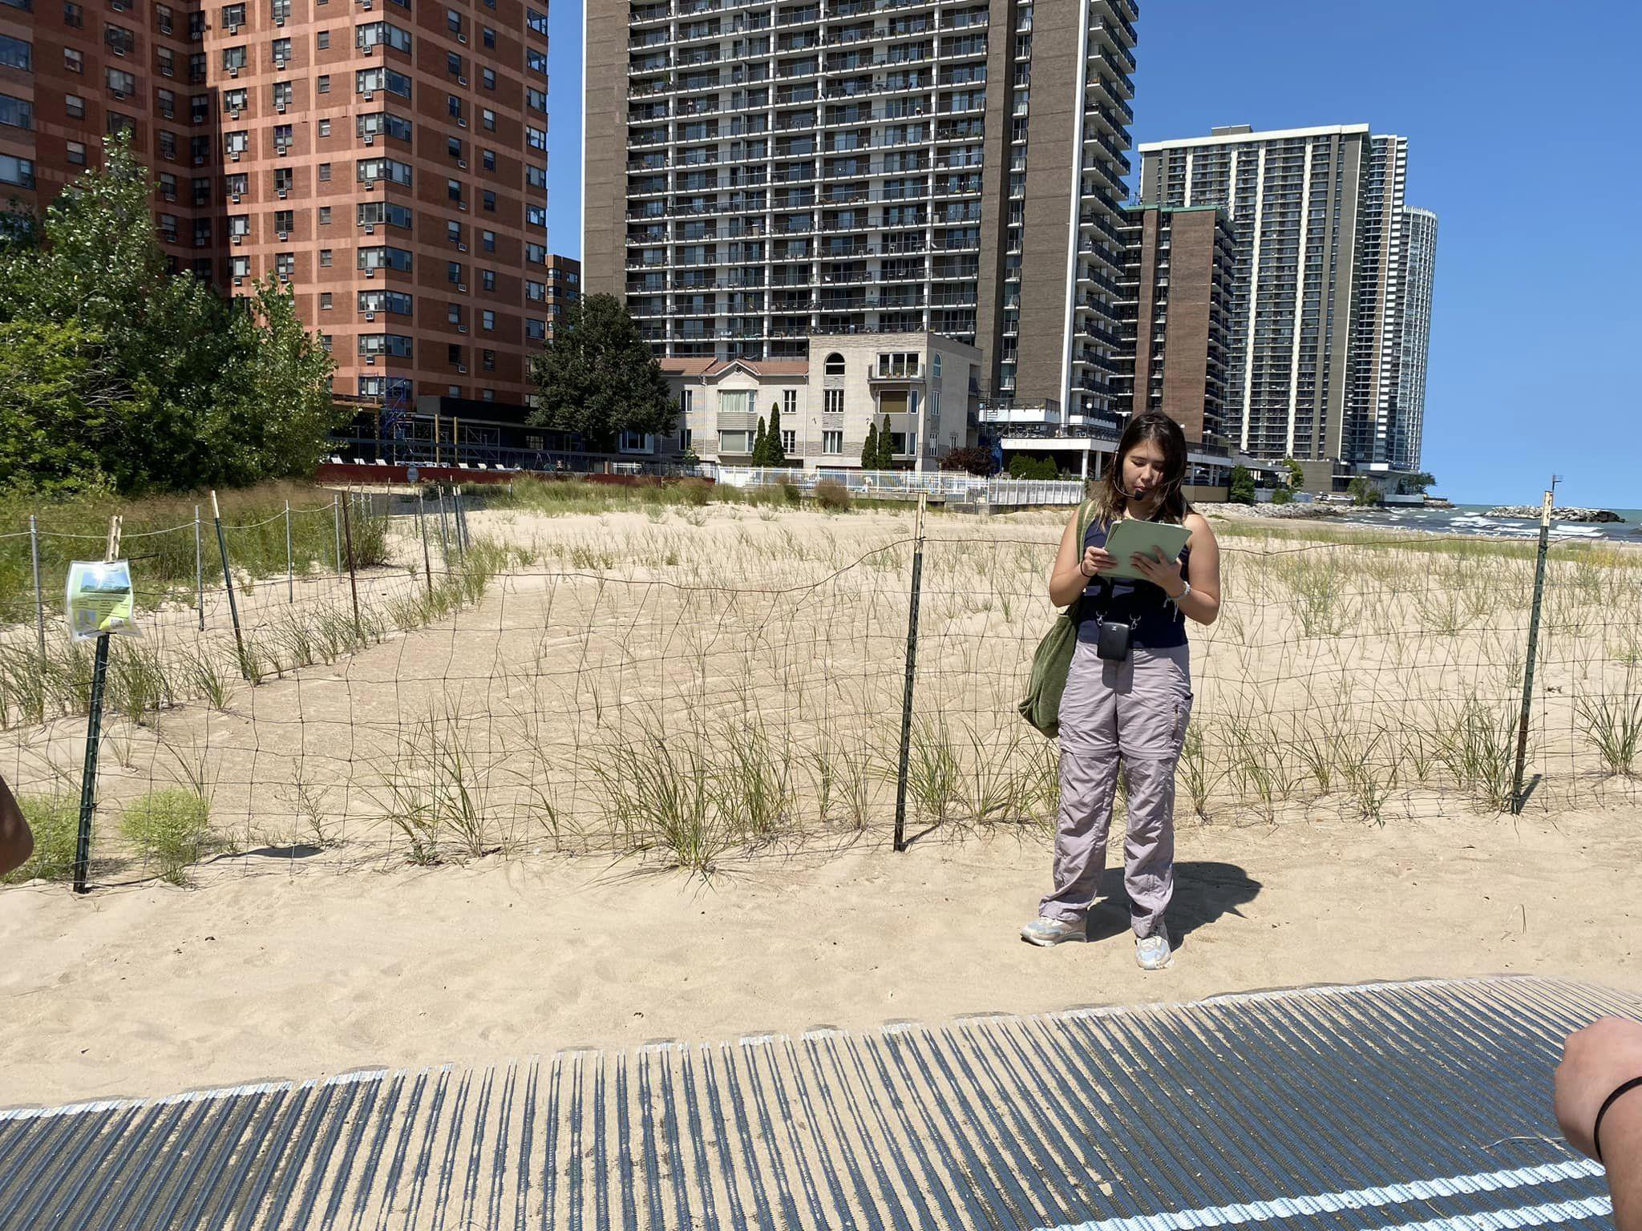
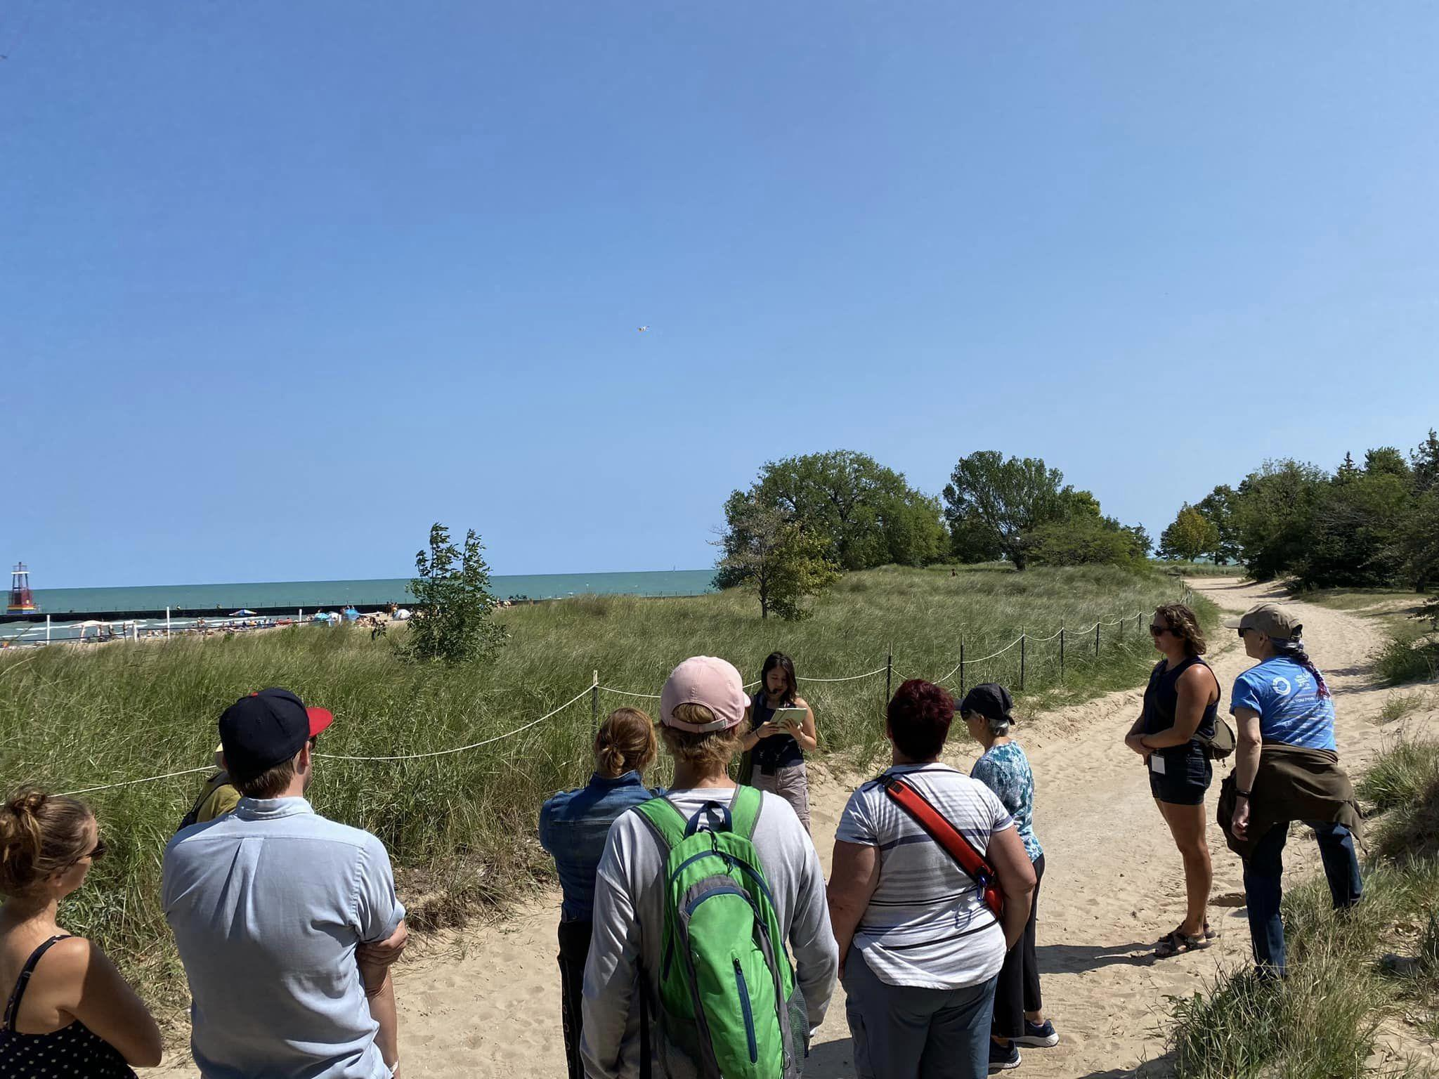
Why Collect?
Cost effective
Essential to restoring local habitats
Increases biodiversity
Can share/swap
You know what you are planting
(if you labeled well)
Notes:
One reason is to be absolutely sure of what seeds you have. Some of you may have heard of, and been affected by #Peppergate. This year, gardeners across the country thought that they were planting one kind of pepper only for the plants to grow something entirely else. How did this happen? Its speculated that some sort of mix up happened at one of the seed distribution companies. What complicates things is that one company may sell seeds through multiple company names or smaller companies may work with larger ones for supply. The number of companies has shrunk over the years as companies consolidated. This means that when one things go wrong at one company, it effects gardeners across the country.

Slide 5
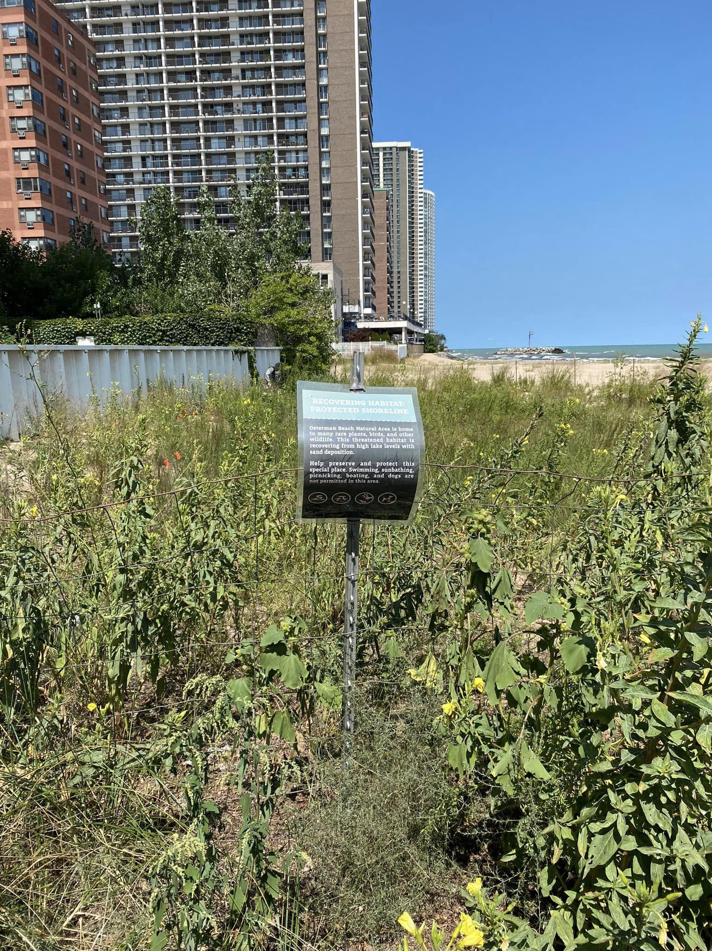
Permissions & Ethics
Where to collect
Private spaces
  Fellow gardeners and community gardens
Public Spaces
  It is illegal to collect from government owned “wild” areas like nature preserves . . . without permission
  If you’re looking to collect from such a space, see if it has a site steward who might be able to grant permission
Collect Using the Rule of Thirds
⅓ for yourself, ⅓ for wildlife, ⅓ to grow for next year
Notes:
Where to Collect: Do you envy your neighbor’s garden? Most gardeners like to share, so don’t be shy about asking permission to harvest. As you know, community gardens can also be a great resource.
It is illegal to collect from state and federally owned wild areas . . . without permission.
If you’re looking to collect from a public space, see if it has a site steward who might be able to grant you permission.
Collect using the Rule of Thirds: You want to collect no more than a third for yourself, leave a third for wildlife, and leave a third to grow next year. Many native plants, including milkweed species, are self-seeding and need seeds left behind to support monarchs in the future.

Slide 6
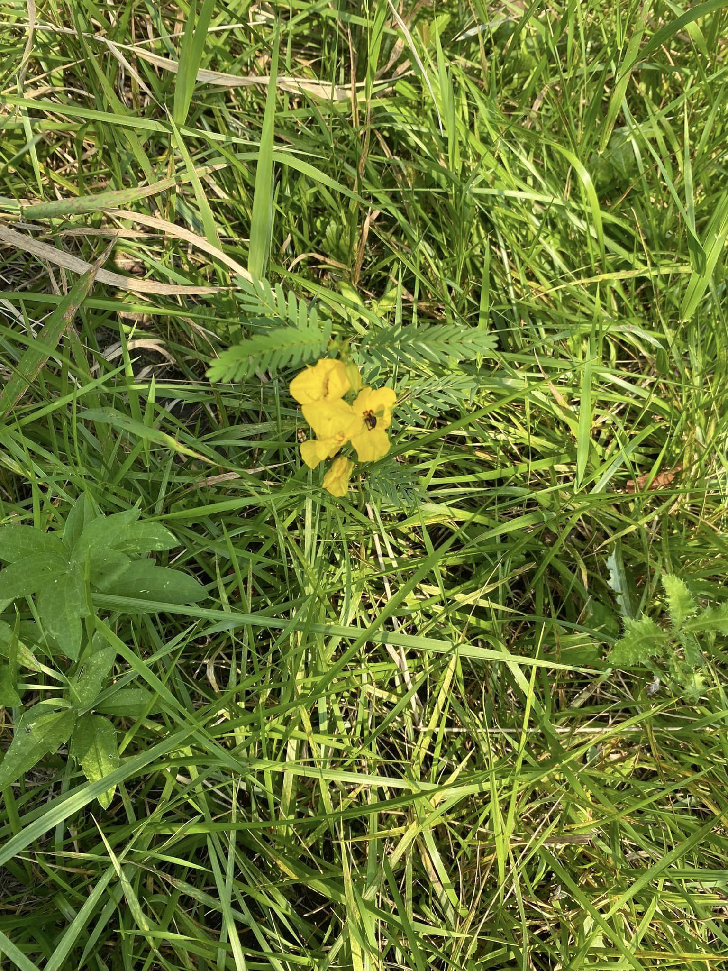
Preparation - Ask Yourself
Figure out the Who, What, Where, When, How
Who do you need permission from
What seeds do you want to collect
Where you will collect from
When the best time to collect is
How those seeds need to be collected
Notes:
Where to Collect: Do you envy your neighbor’s garden? Most gardeners like to share, so don’t be shy about asking permission to harvest. As you know, community gardens can also be a great resource.
It is illegal to collect from state and federally owned wild areas . . . without permission.
If you’re looking to collect from a public space, see if it has a site steward who might be able to grant you permission.
Collect using the Rule of Thirds: You want to collect no more than a third for yourself, leave a third for wildlife, and leave a third to grow next year. Many native plants, including milkweed species, are self-seeding and need seeds left behind to support monarchs in the future.

Slide 7
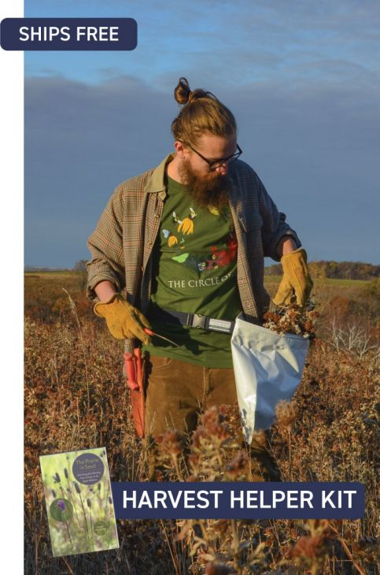
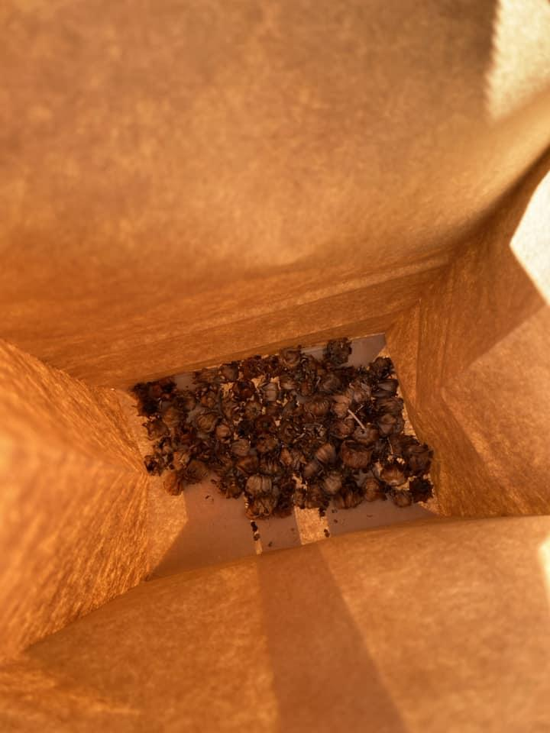
Preparation - Equipment
Gather Your Equipment
Be as fancy or as DIY as you’d like
Suggestions
Containers - plastic bags, paper bags, sacks, buckets
  Make sure that they are clean and dry to prevent mold, etc
Labels - more on this later
Scissors/pruning shears
Gloves - for dealing with burrs, sap, etc
Appropriate clothing - pants tucked into socks to prevent ticks
Camera - to document location, type, etc
Water - for hydration and to wash your hands after handling toxic/poisonous/irritating materials
Notes:
Top image is a Harvest Helper Kit from Prairie Moon Nursery, bottom image is of seed heads in a paper bag

Slide 8
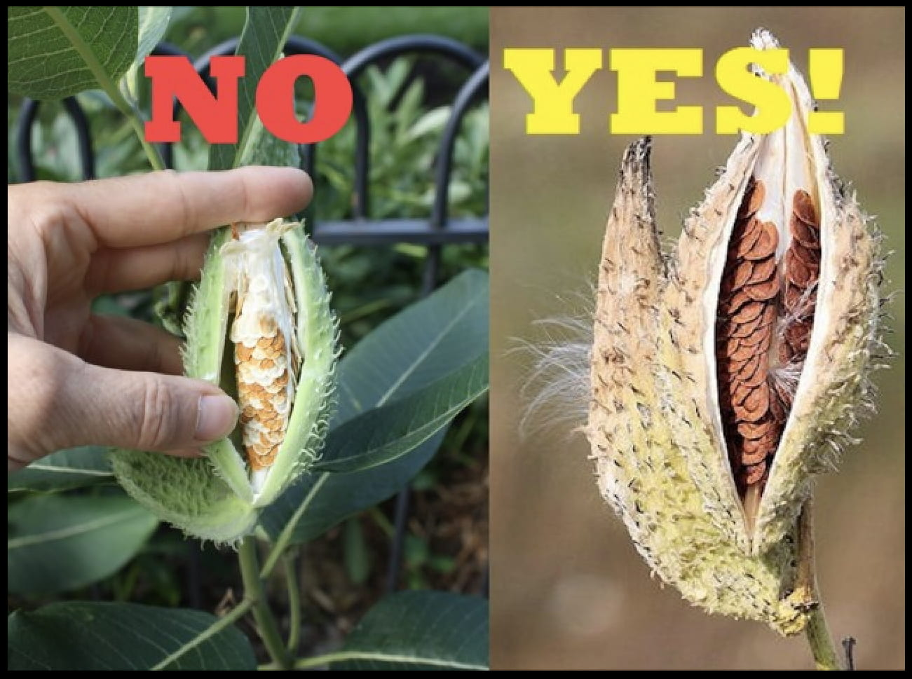
Preparation - Timing
No hard and fast rule
Look for changes in color, texture and more
Can be affected by delayed frost, drought, rain, unexpected high or low temperatures
If possible, collect on multiple dates
  Use mesh jewelry bags when seeds aren’t ready or explosive species
  https://youtu.be/FvCaDK_rlCk?feature=shared
Image from https://bygl.osu.edu/node/1167

Slide 9
Collecting
Variety
Collect from multiple plants of the same type to prevent inbreeding
If possible, collect from edges, difficult to access areas and microclimates
Don’t avoid less robust looking plants
Be Bad at It
This is the one time it’s okay to litter
Make sure to leave seed behind on the ground and on the plants
Spiders Happen
Please be kind and let them out at their home

Slide 10
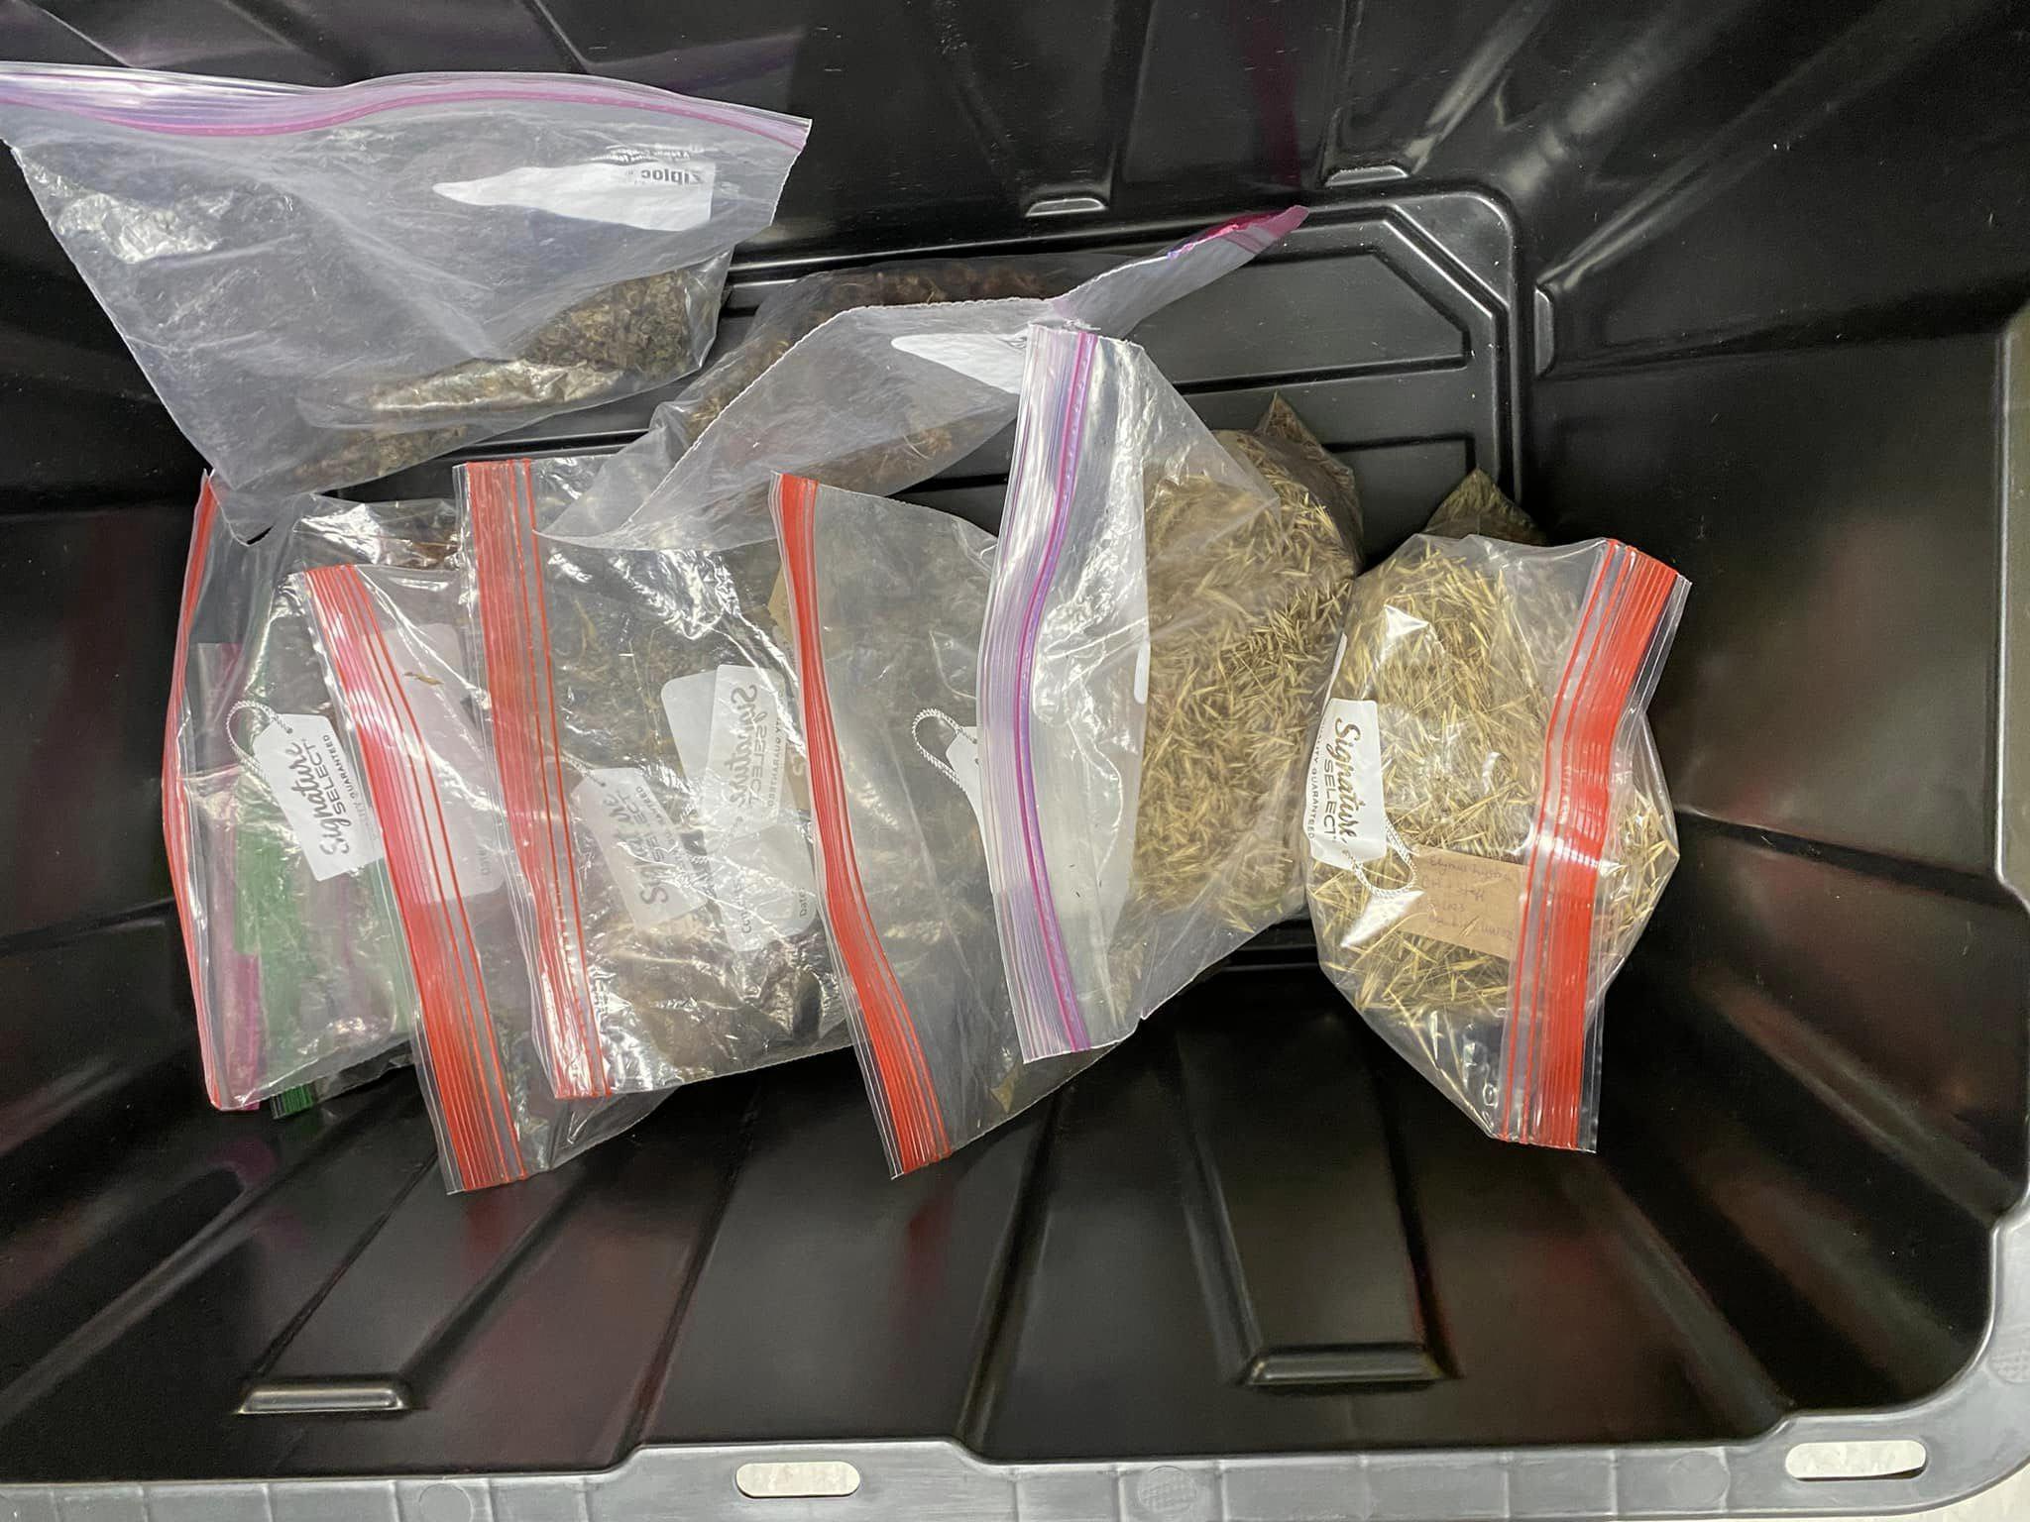
Collecting - Paper or Plastic
Paper Bags
Not ideal for small seeds - they can get caught in the crevices
Great for drying
Ziploc Bags
Great for all sizes
Not ideal for drying
Encourages mold
Temperature matters

Slide 11
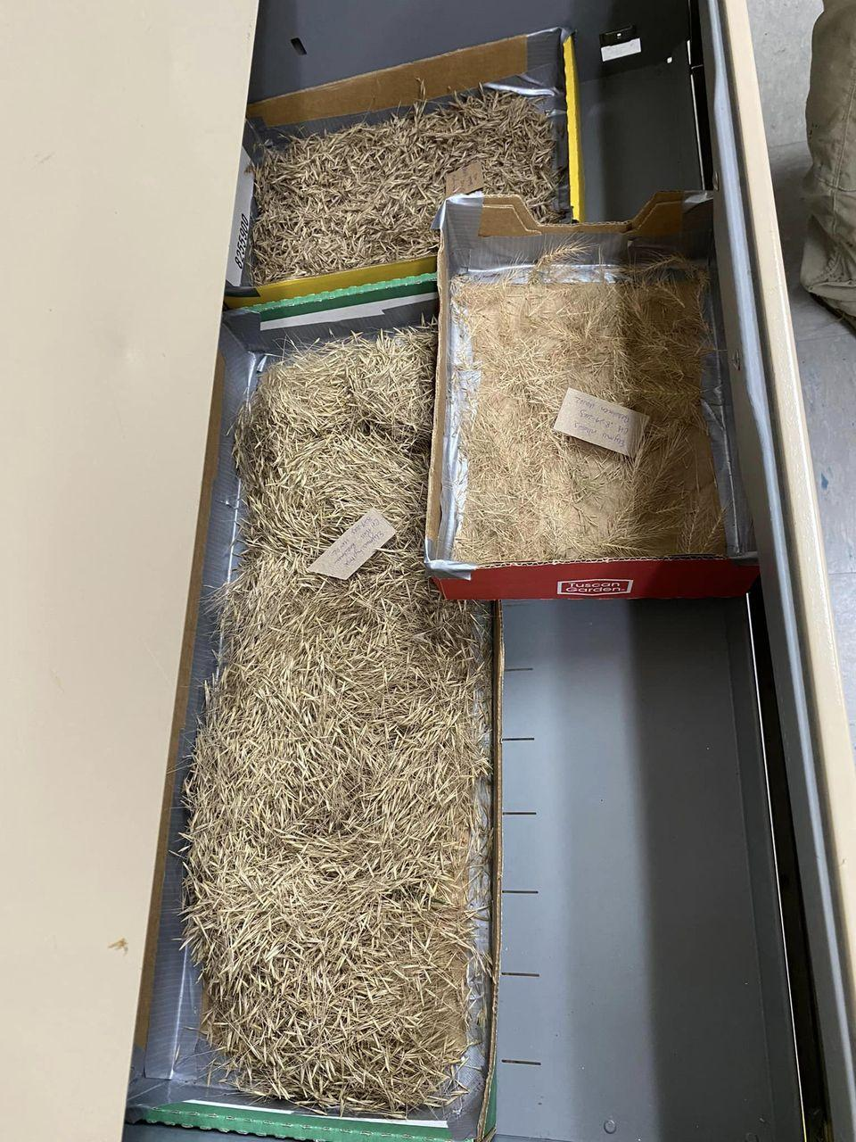
From Collecting to Storing - Temperature Matters
Seeds left in a vehicle will overheat
Collecting in plastic bags on a hot day can cause a greenhouse effect
High temperatures reduce viability of germination
Dry/process seeds as soon as possible

Slide 12
Cleaning & Drying
Remove any chaff from “dry” seed - for seeds like milkweed, remove the fluff/coma by gently rubbing the seeds between your fingers
Or use a shopvac
For “wet” seeds like berries - mash and rinse seeds under running water until all pulp is removed
If possible, dry seeds in a 50-77 degree well ventilated area
  Avoid rooms with major temperature and humidity fluctuations like bathrooms and kitchens
  A space where animals and bugs can’t get to them
  Be prepared for smells, especially with penstemon
Spread on brown paper, newspaper or mesh sieves
Some seeds will need 2-3 weeks to dry, some months

Slide 13
Labeling
Label! Label! Label!
At a minimum a label should include:
  Collection date
  Collection location
  Plant Name (first three letters of the botanical name)
  Recommended: conditions of plant location - soil type, moisture type, sun type
Example: Asc Sul-Rice Gardens-9/30/23-Batch 01
Use documentation to supplement your labels

Slide 14
Storage
A cool dry place like a fridge is ideal
If you can control these features: Humidity + Temperature= 100%
If the temperature is 30, then 70% humidity, if 55, then 45, etc
Containers can be ziploc bags, paper bags, envelopes, or plastic containers
Storing in a medium will help keep temperature consistent and with dispersal when planting
Match the size of the medium to the size of the seed - sand for small, vermiculite for large, etc

Slide 15
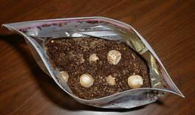
Stratification
Most seeds native to the Midwest will need stratification
Native seed developed to survive our seasons and not germinate too soon
Stratification replicates the freezing process native seeds expect
Place seeds in a container with a damp paper towel or other damp medium
Store there for 4-8 weeks
After the last frost, plant your seeds as you would any other
Image from: https://www.ksuhortnewsletter.org/newsletters/seed-stratification-for-trees

Slide 16
Resources
Webinars How to Collect and Sow your Native Seed - Chicago Living Habitats Harvesting Native Plant Seeds - Sag Moraine Native Plant Community: Native Seed Harvesting - Barrington Area Library Field Guides Seed Collection Field Guides Plant ID Apps Pl@ntNet iNaturalist | Collection Timing Charts Northern Illinois Native Seed Phenology – Woods to Wetlands Seed Collection Dates - Pleasant Valley Conservancy Seed Collecting – Tallgrass Prairie Center Modules Seed Conservation Modules - Botanic Gardens Conservation International

